Slide 1
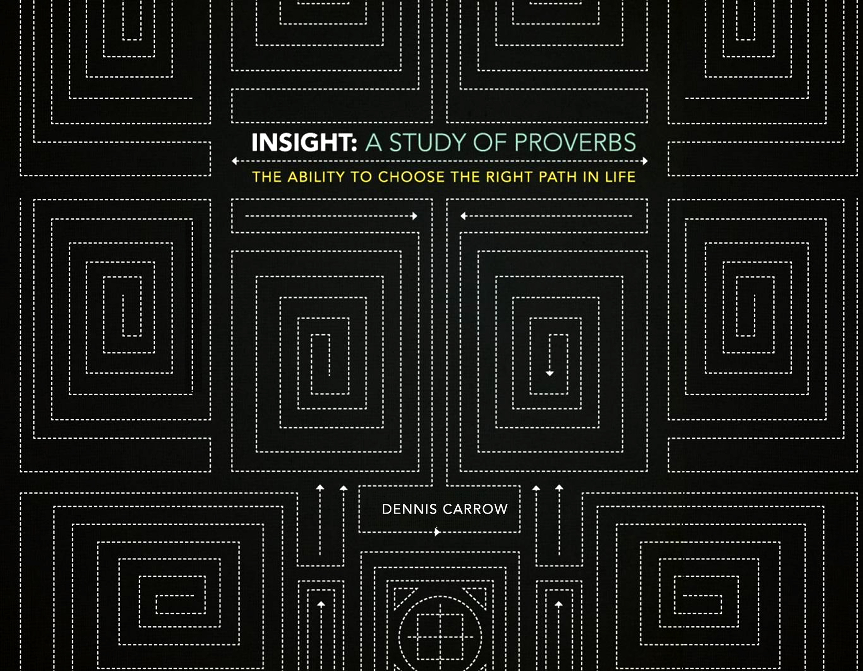

Slide 2
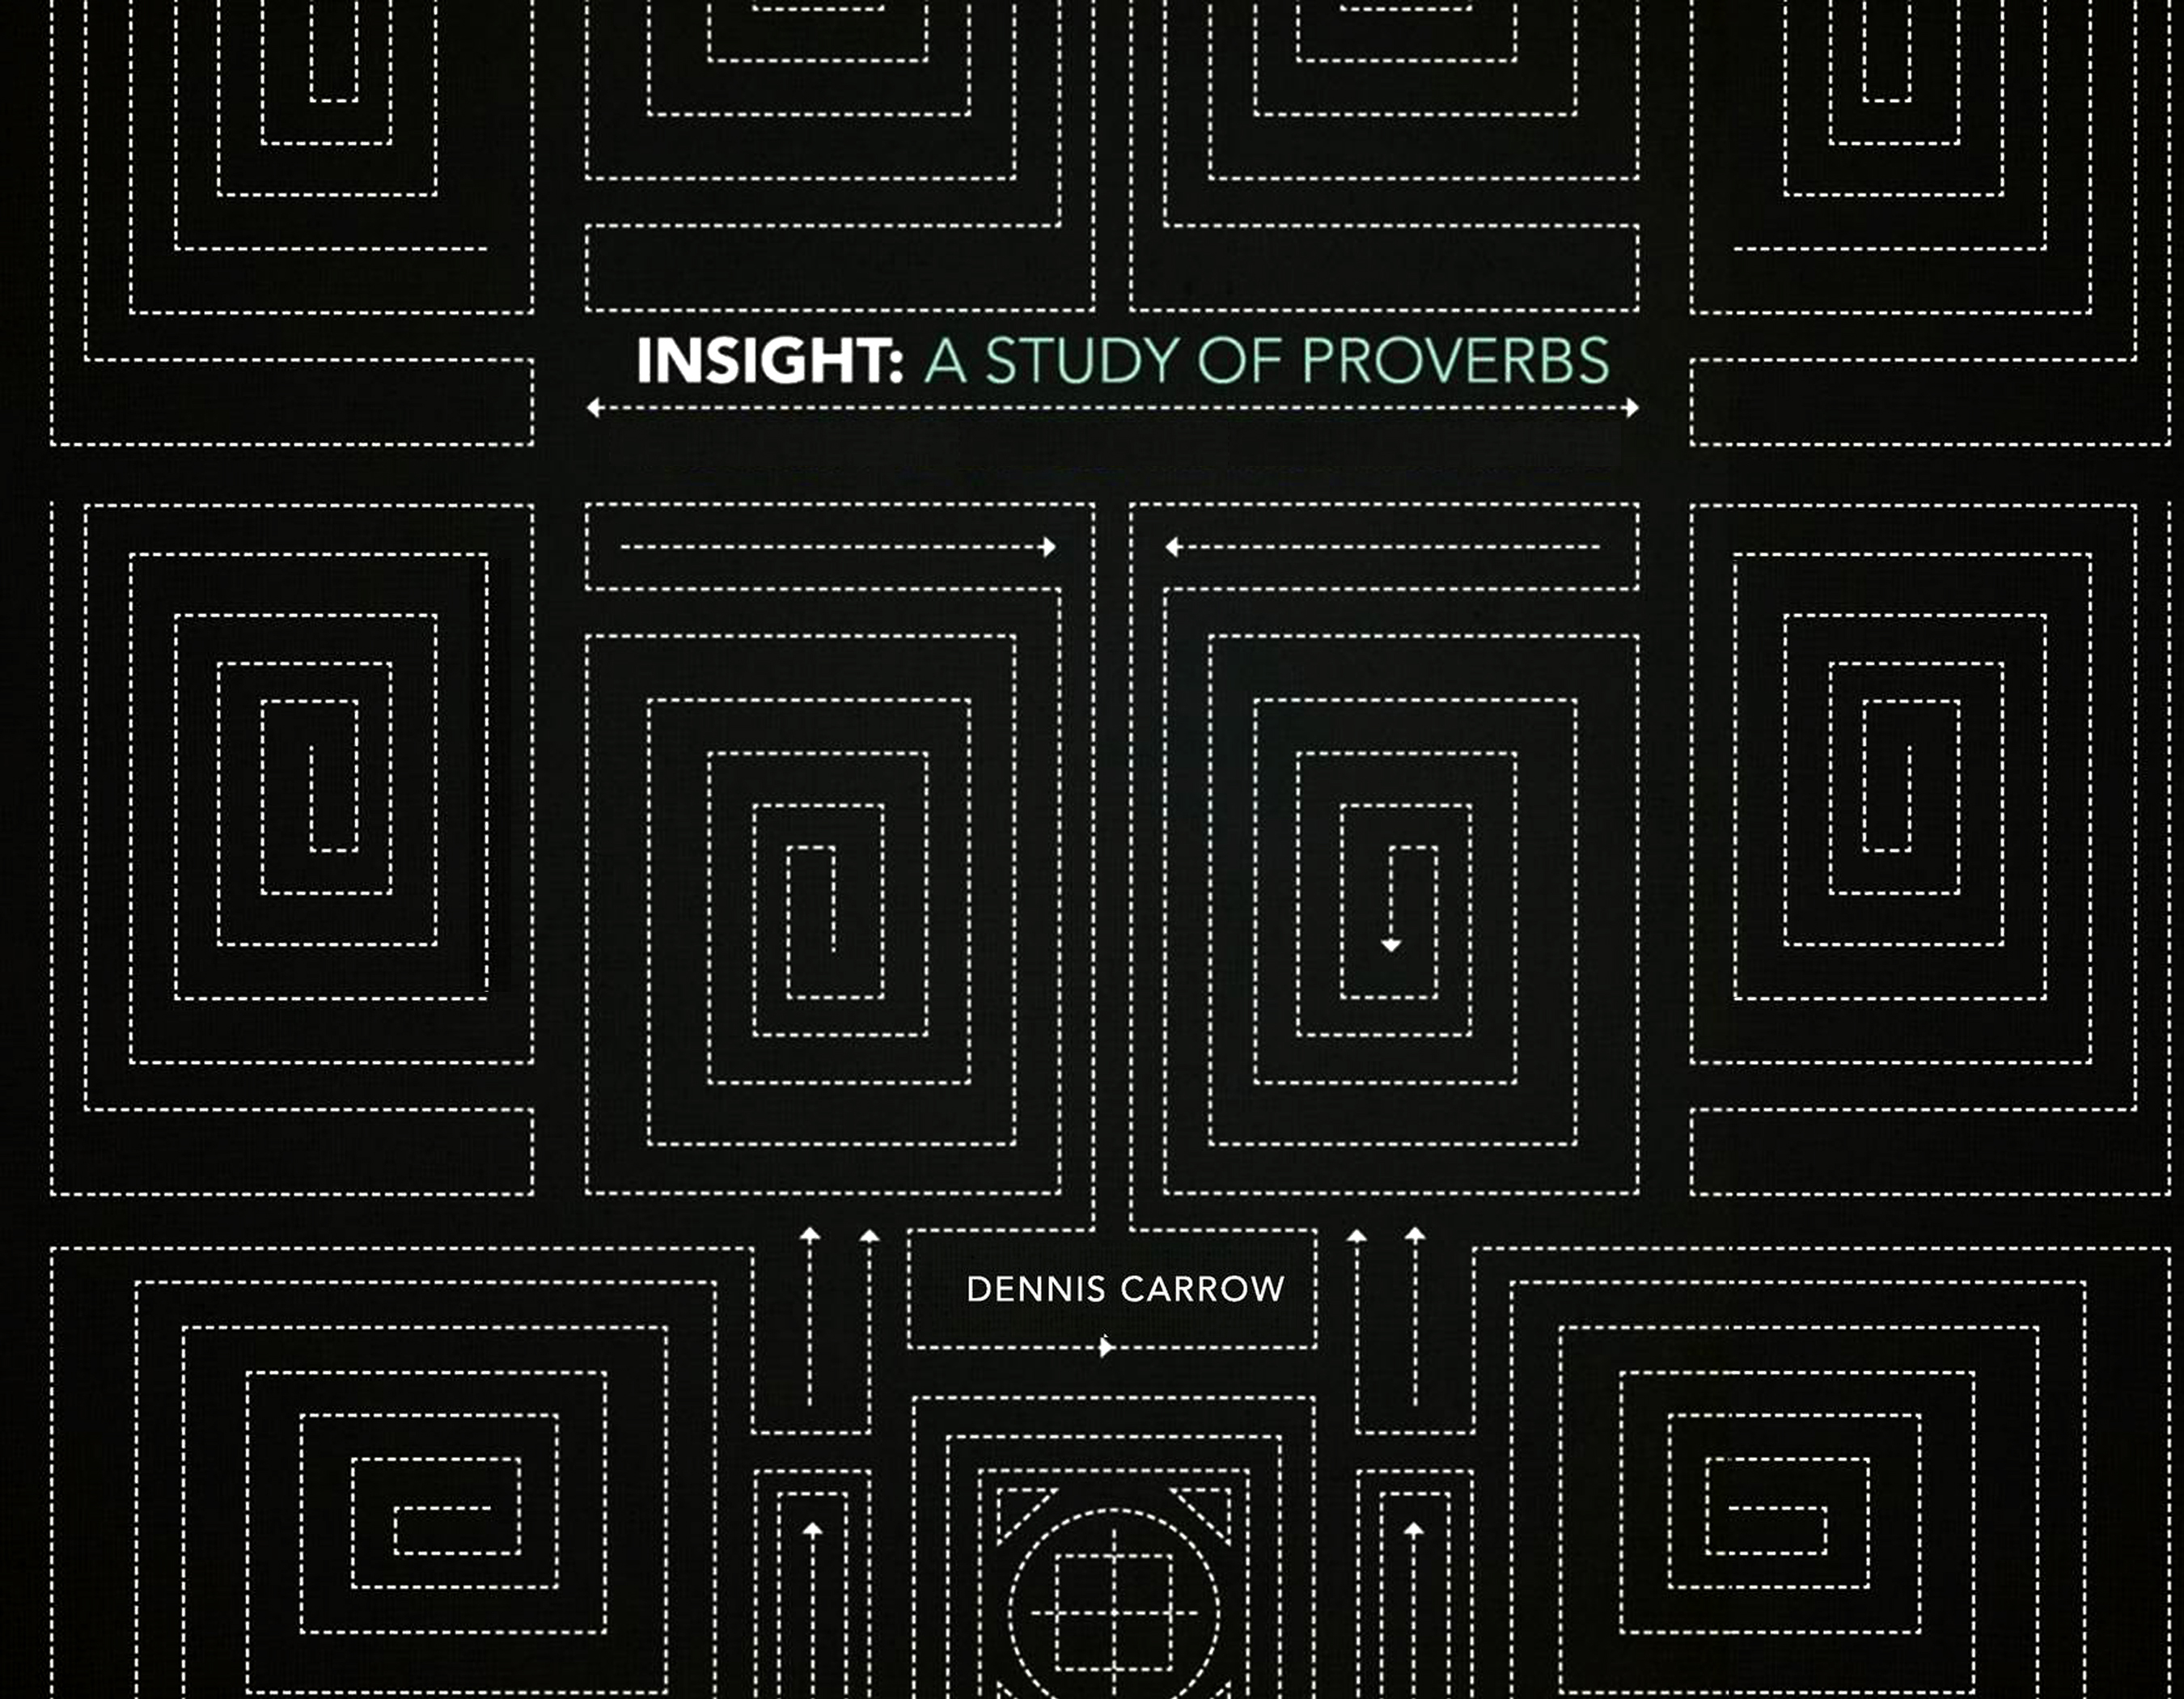
Introduction

Slide 3

Introduction
The Wisdom that Comes from God
What are proverbs?
Sayings or sentences of ethical wisdom
It is the proper application of knowledge that gives birth to wisdom.

Slide 4
A wise man does not think he knows everything!
(Proverbs 1:2-6)
Foundational principle:

Slide 5
Where We Begin:
The Fear Of The Lord
Proverbs 1

Slide 6
Lesson 1
Where We Begin: The Fear of the Lord
Fear “in one sense, is defined as the “instinctive emotion aroused by impending or seeming danger” (New Webster’s Dictionary).
To “stand in awe” or respect.
Both definitions must be applied to the beginning of wisdom.

Slide 7
Godly Instruction vs.
Sinful Enticement
Proverbs 1:7-9, 10-19, 20-23
Where We Begin: The Fear of the Lord

Slide 8
Where We Begin: The Fear of the Lord
Wisdom cries out...I will make known my words to you (vs. 20-23).
Sinners entice...come with us, we shall fill our houses with precious possessions (vs. 11-14).

Slide 9
The Failure in Rejecting Wisdom
Proverbs 1:24-33
Where We Begin: The Fear of the Lord
The text does not imply that God rejects men who come to a knowledge of the truth and repent, but those who have lost sight of reality by rejecting His word

Slide 10
The key to the promises of peace, protection, contentment, and happiness…
“The wise man will hear.”
Where We Begin: The Fear of the Lord

Slide 11
Memorize and meditate
“My son, if sinners entice you do not consent.”
Proverbs 1:10
Where We Begin: The Fear of the Lord

Slide 12
Where We Begin: The Fear of the Lord
What determines the difference between the foolish and the wise?
What criminal activity today mirrors that mentioned in verse 14?
What is the response of the wise to those who attempt to involve us in things that are wrong?
Why will God not answer those in trouble in verses 28-30?
In light of the things God has revealed in this study, how will you respond in prayer to Him?

Slide 13
The Storehouse for Wisdom:
A Good and Honest Heart

Slide 14
The Prerequisite to Obtaining Wisdom from God
Proverbs 2:1-9
The Storehouse For Wisdom: A Good & Honest Heart
Receive and value the commands (v. 1)
Listen and apply wisdom and understanding (v. 2)
Diligently seek to make proper decisions (v. 3)
Search for truth above all else (v. 4)
Then, we will receive understanding and knowledge (v. 5).

Slide 15
The Effect of the Wisdom of
God in Your Heart
Proverbs 2:10-22
The Storehouse For Wisdom: A Good & Honest Heart
When we adopt the proper attitude toward God and His word He transforms our life.

Slide 16
The Storehouse For Wisdom: A Good & Honest Heart
Identify and discuss five things required in order to obtain wisdom.
How can we prevent being led down the road with the unrighteous?
Define moral courage.

Slide 17
The Benefit of Wisdom: Character, Confidence, & Contentment

Slide 18
The Benefits Of Wisdom:
Character, Confidence, & Contentment
Consider the things you hope to get out of life.
Long Life (vv. 2, 16)
Favor and High Esteem (v. 4)
Health and Strength (v. 8)
Material Blessings (v. 10)
Happiness, Rest, and Peace (vv.17,18,24)
Deliverance From Trouble (vv. 25,26)
Eternal Life (vv. 35)

Slide 19
Trust in the Lord and He will Direct and Bless Your Life
(Read Proverbs 3:1-10)
The Benefits Of Wisdom:
Character, Confidence, & Contentment

Slide 20
Some Lessons Not Easily Learned, but the Result is Priceless Peace
(Read Proverbs 3:11-18)
The Benefits Of Wisdom:
Character, Confidence, & Contentment

Slide 21
The Creative Power of Wisdom
(Read Proverbs 3:19-26)
The Benefits Of Wisdom:
Character, Confidence, & Contentment

Slide 22
Share That Which God Gives With Others
(Read Proverbs 3:27-35)
The Benefits Of Wisdom:
Character, Confidence, & Contentment

Slide 23
Meditate and Memorize:
The Lord will be your confidence, and keep your foot from being caught (vs. 26)
The Benefits Of Wisdom:
Character, Confidence, & Contentment
Remember our purpose of gaining wisdom is to learn how to make the right decisions in our life, without having to experience those things that are wrong.

Slide 24
The Benefits Of Wisdom:
Character, Confidence, & Contentment
Discuss some benefits you have received by making application of wisdom in you life.
What is the result of rejecting God’s instruction?
What do we learn in v. 3 about the nature of wisdom?
Explain how we bind God’s commands around our neck and write them on the tablets of our heart.
How can a person lose wisdom?

Slide 25
The Effects Of Wisdom:
Preservation & Contentment

Slide 26
First Things First:
Listen, Learn, and Live
(Read Proverbs 4:1-9)
The Effects Of Wisdom: Preservation & Contentment

Slide 27
Learning From the Past Clears the Path to the Future
(Read Proverbs 4:10-13)
The Effects Of Wisdom: Preservation & Contentment

Slide 28
The Blinding Effects of Darkness
(Proverbs 4:14-19)
The Effects Of Wisdom: Preservation & Contentment

Slide 29
Pursuits In Life Begin From Within
(Read Proverbs 4:20-27)
The Effects Of Wisdom: Preservation & Contentment
^{Consider Luke 8:11-18}

Slide 30
Meditate and Memorize:
“Keep your heart with all diligence, For out of it springs the issues of life.”
Proverbs 4:23
The Effects Of Wisdom: Preservation & Contentment

Slide 31
Questions to Consider
The Effects Of Wisdom: Preservation & Contentment
Explain how wisdom can preserve or extend your life.
How are honor and grace created by wisdom?
What is the relationship between what we say and what is in our hearts?

Slide 32
The Blinding Nature Of Immorality:
The Dangers Of Indecency
Proverbs 5, 6, & 7

Slide 33
Immorality Robs Innocence and Takes Away Honor
(Read Proverbs 5)
The Binding Nature Of Wisdom: The Dangers Of Indecency
Loss of honor (v. 9)
Loss of possessions (v. 10)
Loss of purity and possibly infected with disease (v.11)
Public humiliation (vv. 12-14
Loss of direction and spiritual death (vv. 22-23)

Slide 34
Qualities to Possess:
Humility, Honesty, Integrity, and Hard Work.
(Read Proverbs 6:1-19)
The Binding Nature Of Wisdom: The Dangers Of Indecency

Slide 35
Wisdom Will Deliver Us from the Deception of Indecency
(Read Proverbs 6:20-7:27)
The Binding Nature Of Wisdom: The Dangers Of Indecency

Slide 36
Meditate and Memorize:
“Treasure my commands within you. Keep my commands and live.”
Proverbs 7:1,2
(Take a moment to consider
1 Corinthians 6:15-20)
The Binding Nature Of Wisdom: The Dangers Of Indecency

Slide 37
Questions to Consider
The Binding Nature Of Wisdom: The Dangers Of Indecency
1. Is it wrong to be attracted to someone of the opposite sex?
2. How can you identify immoral people?
3. How are we able to avoid committing sexual immorality?
4. How will humility, honesty, integrity, and hard work deliver you from immoral people?

Slide 38
Light To Life By: The Excellent Way Of Wisdom
Proverbs 8 & 9

Slide 39
Instruction is our Most
Valuable Commodity
(Read Proverbs 8:1-21)
Light To Live By: The Excellent Way Of Wisdom

Slide 40
God has Opened the Door:
Enter In
(Read Proverbs 9:1-18)
Light To Live By: The Excellent Way Of Wisdom

Slide 41
Meditate and Memorize:
“I love those who love me, and those who seek me diligently will find me.”
Proverbs 8:17
Light To Live By: The Excellent Way Of Wisdom

Slide 42
Questions to Consider
Light To Live By: The Excellent Way Of Wisdom
Find two things that inform us what the fear of the Lord is.
What do foolishness and wisdom have in common?
How does wisdom accomplish all the things it claims in this study?

Slide 43
Ensuring Success: Wisdom’s Way Of Doing Business
Proverbs 10 - 13

Slide 44
Dedicated Commitment with an
Everlasting Foundation.
(v. 25b)
(Read Proverbs 10)
Ensuring Success: Wisdom’s Way Of Doing Business

Slide 45
Qualities Insuring Success:
Grace, Mercy, and Generosity
(Read Proverbs 11)
Ensuring Success: Wisdom’s Way Of Doing Business

Slide 46
Diligence Is Man’s Precious Possession
(Read Proverbs 12 [note v. 27b])
Ensuring Success: Wisdom’s Way Of Doing Business

Slide 47
Identifying and Obtaining True Wealth
(Read Proverbs 13)
Ensuring Success: Wisdom’s Way Of Doing Business

Slide 48
Meditate and Memorize:
“Anxiety in the heart of man causes depression, But a good word makes it glad.”
Proverbs 12:25
Ensuring Success: Wisdom’s Way Of Doing Business

Slide 49
Questions to Consider
Ensuring Success: Wisdom’s Way Of Doing Business
Examine and discuss the following passages concerning the importance of developing the ability and proper manner in which we communicate with others.
  Proverbs 10:11
  Proverbs 11:9,11
  Proverbs 12:13, 17-22
Why is diligence your precious possession? (12:27)
What is the result of diligently seeking righteousness?

Slide 50
Introspection:
The Wise Heart Knows Itself
Proverbs 10 - 13

Slide 51
An Open Mind Finds Wisdom
(Read Proverbs 14:1-9)
Introspection: The Wise Heart Knows Itself

Slide 52
The Volatility of the Conscience
(Read Proverbs 14: 10-14)
Introspection: The Wise Heart Knows Itself

Slide 53
The Walk of the Wise Looks Carefully Where He Steps
(Read Proverbs 14:5-25)
Introspection: The Wise Heart Knows Itself

Slide 54
Oppression, Anger, and Envy - A Reproach to Any People
(Read Proverbs 14:26-35)
Introspection: The Wise Heart Knows Itself

Slide 55
Meditate and Memorize:
“There is a way that seems right to a man, But its end is the way of death.”
Proverbs 14:12
Introspection: The Wise Heart Knows Itself

Slide 56
Questions to Consider
Introspection: The Wise Heart Knows Itself
What two elements are essential in gaining understanding? (Vs. 6b, 29)
Discuss how we identify being filled with our own ways as opposed to being satisfied from above.
Read and discuss Philippians 4:6-7, 11-13.

Slide 57
The Mirror Of Our Heart:
The Word We Speak
Proverbs 15 & 16

Slide 58
Proper Disposition and Doctrine Make the Difference
(Read Proverbs 15)
The Mirror Of Our Heart: The Words We Speak
Proper communication:
Brings a cheerful countenance. V. 13
Calms contentions. V. 18
Lives joyfully. V. 23

Slide 59
A Submissive Mind Leads to the Control of the Tongue
(Read Proverbs 16)
The Mirror Of Our Heart: The Words We Speak
We prepare the heart to receive instruction, God provides the words of instruction (v. 1).
We commit our actions to things right,
God establishes our thoughts (v. 3).
When we please God, He provides peace (v. 7).
We plan our lives around God, God directs our steps (v. 9).

Slide 60
Meditate and Memorize:
“Pride goes before destruction and a haughty spirit before a fall.”
Proverbs 16:18
The Mirror Of Our Heart: The Words We Speak

Slide 61
Questions to Consider
The Mirror Of Our Heart: The Words We Speak
How should we respond to someone is angry with us?
What is the best method to use in making plans for the future (15:22)?
What does a positive attitude, pleasant words, and a heart that trusts in God have in common (15:13,26; 16:20)?

Slide 62
Seeking Love:
Tests Of True Friendship
Proverbs 17 - 19

Slide 63
Proper Relationships are Formed by Those Who Seek Love
(Read Proverbs 17)
Seeking Love: Tests Of True Friendship
How do you respond to:
Lies and unkind things said about others (v. 4)?
News of tragedy or trouble experienced by others (v. 5)?
The mistakes and shortcomings of others (v. 9; Matt. 18)?
Someone correcting you (vv. 10,11)?

Slide 64
Seeking Love: Tests Of True Friendship
Friendship qualities are developed by:
Resolving problems before they start. (V.14) Keeping a secret (vs. 9).
Being loyal in times of trouble (vs. 9,17).
Two critical aspects in all relationships is maintaining a calm disposition at all times, and thinking things through before you say them (vs. 27-28).

Slide 65
Self-Centered Conversation is a Reproach to One’s Character
(Read Proverbs 18)
Seeking Love: Tests Of True Friendship

Slide 66
Seeking Love: Tests Of True Friendship
A practical application of effective communication is to express appreciation for an anticipated desirable response (v. 16).
Be prepared for a rebuttal when stating your side of some occurrence (v. 17).
Sometimes the best method of settling a matter is to flip a coin (v. 18).

Slide 67
Seeking Love: Tests Of True Friendship
Saying the wrong thing can create a wall of resistance (v. 19).
The art of persuasion is the best approach for the underdog (v. 23).
To find a life long companion is a good thing (v. 22)!

Slide 68
Fair Weathered Friends Will Fail Us
(Read Proverbs 19)
Seeking Love: Tests Of True Friendship

Slide 69
Meditate and Memorize:
“A man who has friends must himself be friendly,
But there is a friend who sticks closer than a brother.”
Proverbs 18:24
Seeking Love: Tests Of True Friendship

Slide 70
Questions to Consider
Seeking Love: Tests Of True Friendship
Make a practical application of 17:13. Identify at least two aspects of being a good friend.
  ______________________________________
  ______________________________________
How is a merry heart like medicine (17:22) and how does the spirit of man sustain him in sickness (18:14a)?

Slide 71
Obstruction To Wisdom:
A Lack Of Discipline
Proverbs 20 -23

Slide 72
Sobriety Today Makes for a
Brighter Tomorrow
(Read Proverbs 20)
Obstruction To Wisdom: A Lack Of Discipline

Slide 73
Contentment, Moderation, and Planning Today Leads to a Prosperous Tomorrow
(Read Proverbs 21 and 22)
Obstruction To Wisdom: A Lack Of Discipline

Slide 74
Many Things Deceive - Consider Carefully What is Before You
(Read Proverbs 23)
Obstruction To Wisdom: A Lack Of Discipline

Slide 75
Meditate and Memorize:
"He who follows righteousness and mercy finds life, righteousness and honor."
Proverbs 21:21
Obstruction To Wisdom: A Lack Of Discipline

Slide 76
Questions to Consider
Obstruction To Wisdom: A Lack Of Discipline
Name three things are necessary to ensure a financially stable future?
Drugs and alcohol being so destructive, why do you suppose so many people use them?

Slide 77
Enlightened Through Observation:
Viewing Others In The Proper Perspective
Proverbs 24

Slide 78
Three Fundamental Essentials
For Spiritual Shelter:
Wisdom, Understanding, and Knowledge
(Read Proverbs 24:1-10)
Obstruction To Wisdom: A Lack Of Discipline

Slide 79
How to Respond to Your
Uninformed Friends
(Read Proverbs 24:11-20)
Obstruction To Wisdom: A Lack Of Discipline

Slide 80
Reprove Error, Respect All Men, and Honor Those in
Positions of Authority
(Read Proverbs 24:21-29)
Obstruction To Wisdom: A Lack Of Discipline

Slide 81
Wisdom Also Comes
Through Observation
(Proverbs 24:30-34)
Obstruction To Wisdom: A Lack Of Discipline

Slide 82
Memorize and Meditate:
“Those who rebuke the wicked will have delight, And a good blessing shall come upon them.”
Proverbs 24:25
Obstruction To Wisdom: A Lack Of Discipline

Slide 83
Questions to Consider
Obstruction To Wisdom: A Lack Of Discipline
Describe the various ways we may judge others.
In what way do those who rebuke the wicked “delight?”

Slide 84
Behavior Management:
Demonstrating Wisdom
Proverbs 25 & 26

Slide 85
Exercise Humility and Patience When Approaching Governing Authorities (Read Proverbs 25:1-15)
Behavior Management: Demonstrating Wisdom

Slide 86
Exercise Caution When
Selecting Relationships
(read Proverbs 25:16-28)
Behavior Management: Demonstrating Wisdom

Slide 87
Identify and Beware of Foolish, Lazy, and Contentious People
(Read Proverbs 26)
Behavior Management: Demonstrating Wisdom

Slide 88
Meditate and Memorize:
“Whoever has no rule over his own spirit is like a city broken down without walls.”
Proverbs 25:28
Behavior Management: Demonstrating Wisdom

Slide 89
Questions to Consider
Behavior Management: Demonstrating Wisdom
Name two qualities we must possess in dealing with governmental authorities.
What is the primary element that should govern all relationships?
Make a practical application of 25:17.
What happens when no one repeats a story they heard about another?
What lesson did you learn from 26:17?

Slide 90
Developing Disposition:
Acquiring Desirable Personality Traits
Proverbs 27 - 29

Slide 91
Know Your Place, Speak Your Piece, and Plan With Purpose
(Read Proverbs 27)
Developing Disposition:
Acquiring Desirable Personality Traits

Slide 92
The Distinguished Personality of the Righteous
(Read Proverbs 28)
Developing Disposition:
Acquiring Desirable Personality Traits

Slide 93
The Effect of Your Positive
Personality On Others.
(Read Proverbs 29)
Developing Disposition:
Acquiring Desirable Personality Traits

Slide 94
Meditate and Memorize:
“A man is valued by what others say of Him.”
Proverbs 27:21b
Developing Disposition:
Acquiring Desirable Personality Traits

Slide 95
Questions to Consider
Developing Disposition:
Acquiring Desirable Personality Traits
Why is an open rebuke better than concealed love (27:5)?
How can ones prayer be an abomination?
Name three desirable personality traits we need to acquire.

Slide 96
Illuminating Our World:
Absolutes From God In The Observations Of Man
Proverbs 27 - 29

Slide 97
Two Things To Ask of God:
Truth and Contentment
(Read Proverbs 30:7-10)
Illuminating Our World: Absolutes From God In The Observations Of Man

Slide 98
Deception, Disrespect, Discontent:
A Generation Lost in Sin
Read Proverbs 30:11-20
Illuminating Our World: Absolutes From God In The Observations Of Man
Disregard and disrespect for authority (v. 11).
Pride (v. 12).
Self-delusion (v. 13).
Cruel and Merciless (v. 14).

Slide 99
Gaining Wisdom From Observation Things on the Earth
(Read Proverbs 30:21-33)
Illuminating Our World: Absolutes From God In The Observations Of Man

Slide 100
Meditate and Memorize:
“If you have been foolish in exalting yourself, Or if you have devised evil, put your hand to your mouth.”
Proverbs 30:32
Illuminating Our World: Absolutes From God In The Observations Of Man

Slide 101
Questions to Consider
Illuminating Our World: Absolutes From God In The Observations Of Man
What state of mind is reflected in vv. 2–4?
Will God grant the two things requested in v. 8? (Prove your answer).
Relate the observations of the activities of the ant, badger, locust, and spider to wisdom in the life of man.

Slide 102
Reputation:
The Fruit Of Your Labor
Proverbs 31

Slide 103
Solidify a Relationship with Wisdom - Judge Righteously
(Read Proverbs 31:1-9)
Reputation: The Fruit Of Your Labor
Avoid Immorality (v. 3)
Avoid Intoxicants (vv. 4-7)
Be Compassionate and Merciful (vv. 8-9)

Slide 104
The Value of the Virtuous
(Read Proverbs 31:10-31)
Reputation: The Fruit Of Your Labor
Trustworthy (v. 11)
Diligent (vv. 13-15)
Perceptive (vv. 16-18)
Benevolent (vv. 20)

Slide 105
The Value of the Virtuous
(Read Proverbs 31:10-31)
Reputation: The Fruit Of Your Labor
Courageous (v. 21)
Not self-serving (v. 23)
Strong and optimistic (v. 25)
Edifying in speech (v. 26)

Slide 106
Meditate and Memorize:
“Charm is deceitful and beauty is passing, But a woman who fears the Lord, she shall be praised.”
Proverbs 31:30
Reputation: The Fruit Of Your Labor

Slide 107
Questions to Consider
Reputation: The Fruit Of Your Labor
What do the three admonitions of vv. 3-9 summarize?
What do you consider the most notable qualities of the virtuous woman?
Be prepared to discuss what you consider the most significant benefit you have drawn from your study of the book of Proverbs.

